Slide 1
DevOps for Xamarin

Slide 2
DevOps
Plan + Track
Release
Development
Production
Develop + Test
Monitor + Learn
Notes:
Talking Points:
What is DevOps?
The union of people, process, and products to enable continuous delivery of value to our end users.
Why is it important?
DevOps integrates development teams and operations teams in order to improve collaboration, productivity, and be more responsive to business needs. This is accomplished by automating infrastructure, automating workflows, and continuously measuring application performance. Teams work better together and think more alike by breaking down silos and sharing responsibilities. This will Increase the rate of software delivery and improve the time to market from months/weeks to days/hours.

Slide 3
DevOps for mobile apps
Code Repository
Build + Deploy
Automated Testing
User Beta Testing
iOS
Xamarin Test Cloud
HockeyApp
Backlog
iOS
Visual Studio
Visual
Studio
For
Mac
HockeyApp
Notes:
Talking Points:
Visual Studio Team Services extends the DevOps cycle so it can be applied to you mobile applications, no matter the device or the technology they use. You can use cross-platform capabilities in VS or even other IDEs for mobile development such as Android Studio or Xcode and connect it to Visual Studio Team Services as your code repository.
Visual Studio Team Services can then provide a continuous integration cycle by hosting a cloud build for your mobile application, including builds for iOS that require a OS X operating system to be built.
You can then add automatic testing to your mobile applications and even automatically distribute your app to your beta users, without manual publication into the device stores. All that information including user feedback, crash analytics or usage data can then be brought back to Visual Studio Team Services for the team to close the loop and build a continuous DevOps cycle for their mobile applications.

Slide 4
Build and Deploy – Visual Studio Team Services
Simplify the creation of powerful build deployment pipelines with the deployment tasks
Dozens of tasks exist for build and deployment options across a wide variety of Microsoft, non-Microsoft and OSS technologies
Build steps are easily extensible and an ecosystem of third-party steps are available from the Visual Studio Team Services store

Slide 5
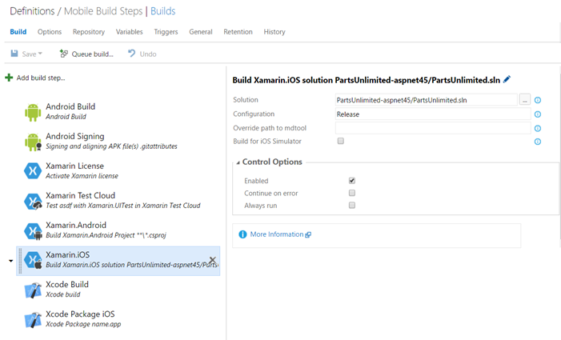
Build and Deploy – Visual Studio Team Services

Slide 6
Testing
Mobile developers face a myriad of challenges
Device fragmentation
Apps are complex
Manual testing is slow and error-prone
Users use apps in unexpected ways

Slide 7
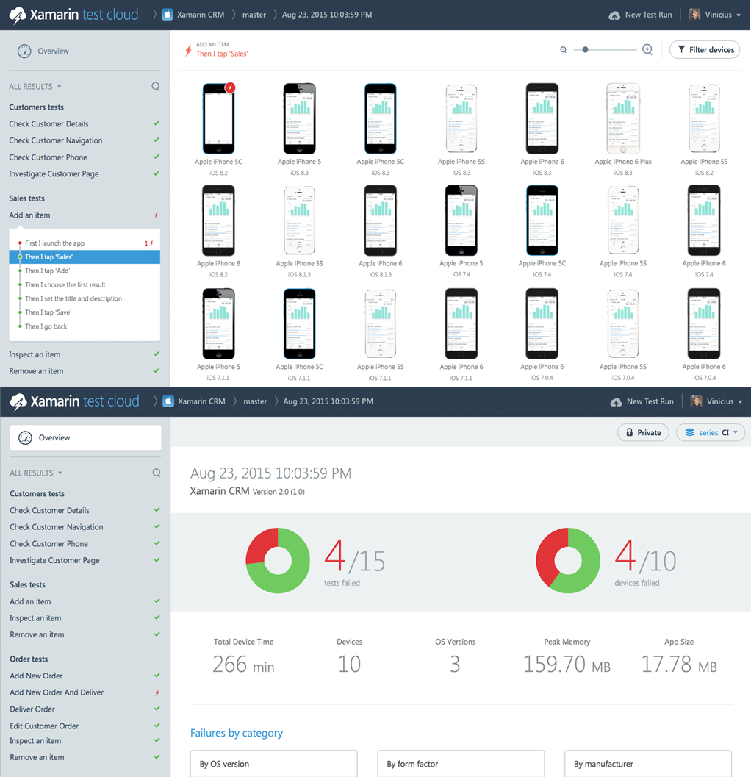
Automated Testing – Xamarin Test Cloud
Diverse library of real devices
Simulate real user interactions
Test continuously
Analyze app performance
Use the tools you know
Test native device functionality

Slide 8
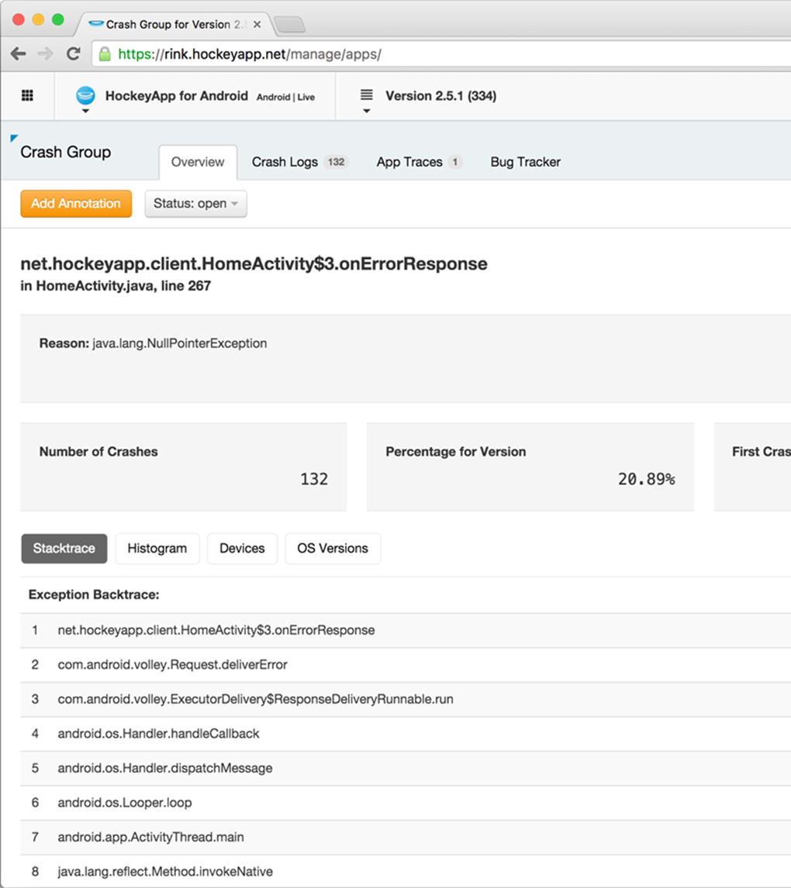
User Beta Testing – Hockey App
Distribute your app
Collect crash reports
Gather user feedback
Understand app adoption
Track app usage

Slide 9
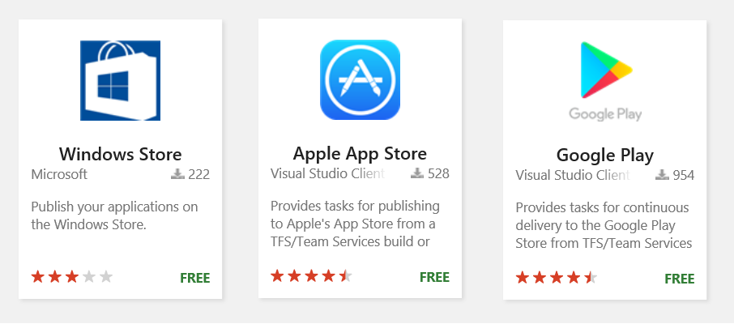
Continuous Delivery to Stores – Visual Studio Team Services
Visual Studio Marketplace Extensions
Tasks for publishing app to:
Google Play, Apple Store and Windows Store

